Slide 1
Distributed Main Memory Database
25 May 2012

Slide 2
Project Agenda
Introduction
Technology Used
How main memory is Distributed
Project Architecture
Why B+ Tree
Database as a server client model
Server Configuration
Screen Sorts
Practical Demonstration
Future Work
Conclusion
Reference

Slide 3
Introduction
It is a memory-resident database that eliminates disk access by storing and manipulating data in main memory.
It is a collection of multiple logically interrelated databases distributed over the computer network, and distributed manager software that manages a distributed database.
It comprises data replication, data fragmentation, distributed query processing, distributed transaction processing, distributed database recovery, etc.
It takes 4ms for each read/write operation in the data base i.e. the secondary memory.
If we create a database in the main memory, it would reduce the time consumption from 4ms to 250 ns.

Slide 4
Introduction(Cont ..)
In this technology instead of creating a database in hard disk we will create a database in the main memory so that read and write activity will be faster.
It is distributed environment so that multiple servers are connected concurrently.
Cloud computing concept is used in this technology.

Slide 5
Technology Used
Socket Programming
Glade Interface Designer(Version 2.12.1)
B+ tree Data structure
UNIX ODBC Driver
with MYSQL Database

Slide 6
How Main Memory is Distributed
The client sends request to the main server.
The main server in turn is connected to many other sub servers.
Client is however unaware about the presence of sub servers that are connected to the main server.
When client sends any request, the main server tries to solve it. If the desired request exceeds the buffer size of the main server, then the server passes the request to a connected sub server which can solve request for its particular buffer size.
While performing all the read/write operations, the data is stored in the main memory in the form of a tree structure i.e. a B+ tree.
When the client exits, data is stored back in the secondary memory (hard disk). This is how the main memory is distributed and the performance is made faster.

Slide 7

Project Architecture
Client1
Server 1
Server 2
Server n
Client2
Main
Memory
B + Tree
B + Tree
B + Tree
Client3
Client4
Database
Database
Database

Slide 8
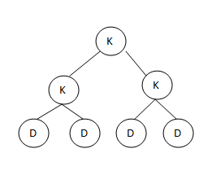
Why B+ Tree
In a general tree, each node contains a single element.
If the height of the tree is large, it is difficult to traverse the tree. Therefore, we need a height balanced tree.
B-Tree is a height balanced tree(each node carries multiple elements).
B+ TREE
B+ Tree
B* Tree
(used to create Database) (used to implement file system)

Slide 9

Database as Server Client Model
All databases are generally server programs.
We are using MYSQL Database.
We require database for faster access and security of data.
To insert a data in the database we require a database client and for that we require some standard(SQL).
For ‘C’ we are using MYSQL since it is open source.
The server name of MYSQL is mysqld and the client name is mysql.

Slide 10
Server Configuration
Socket
Socket is an end point for IPC & RPC over a network.
This is a two way communication mechanism which uses the kernel buffer for communication.
MMDB server uses one socket as the communication channel.
This socket uses IPv4 domain for communication at network layer
This socket uses TCP protocol at the transport layer as it is connection oriented and reliable.
Port No
Port no is used for process to process communication.
MMDB server uses 3500 as port no for communication within the server and also between the sever to client communication.
This MMDB server is a concurrent Server which accept multiple clients concurrently.

Slide 11
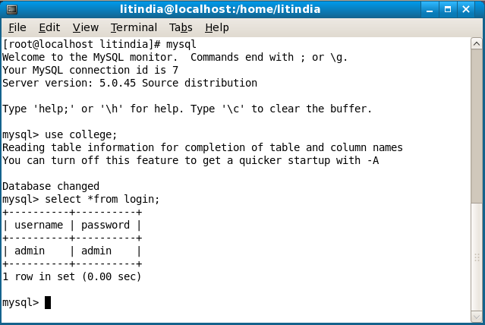
Screen Sorts
-Starting MYSQL Server
-Starting MYSQL Client
-Showing Databases present
-Using required Database
-Showing tables

Slide 12
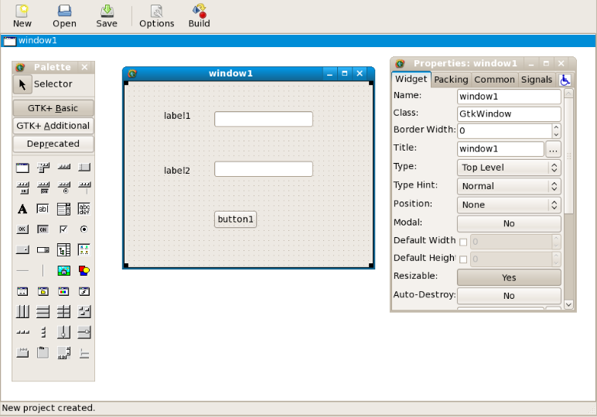
Screen Sorts
Glade Interface Designer
Used For Client

Slide 13
Practical Demonstration

Slide 14
Future Work
Project might be extended to include a larger number of student’s data by connecting to more number of sub servers concurrently.
Searching and Sorting might be included at the client side so that it is easier for the client to access data.

Slide 15
Conclusion
“Distributed Main Memory Database” is designed as DBMS with all data RAM-resident at runtime, because it is implemented over a RAM_BLOCK or RAM Disk.
Therefore the DMMD data structures and access algorithms are optimized to exploit this property for high performance.
In comparison with a fully cached DBMS, DMMD technology uses far less CPU, because the overhead to manage memory buffers and account for multiple data locations (disk and memory) is eliminated.

Slide 16
Reference
GNU Linux Application Programming by M. Tim Jones
Advanced Programming in the UNIX® Environment: Second Edition By W. Richard Stevens, Stephen A. Rago .
http://www.linuxlinks.com
http://wingtk.sourceforge.net

Slide 17
Any Queries?

Slide 18
Thank You

